Slide 1
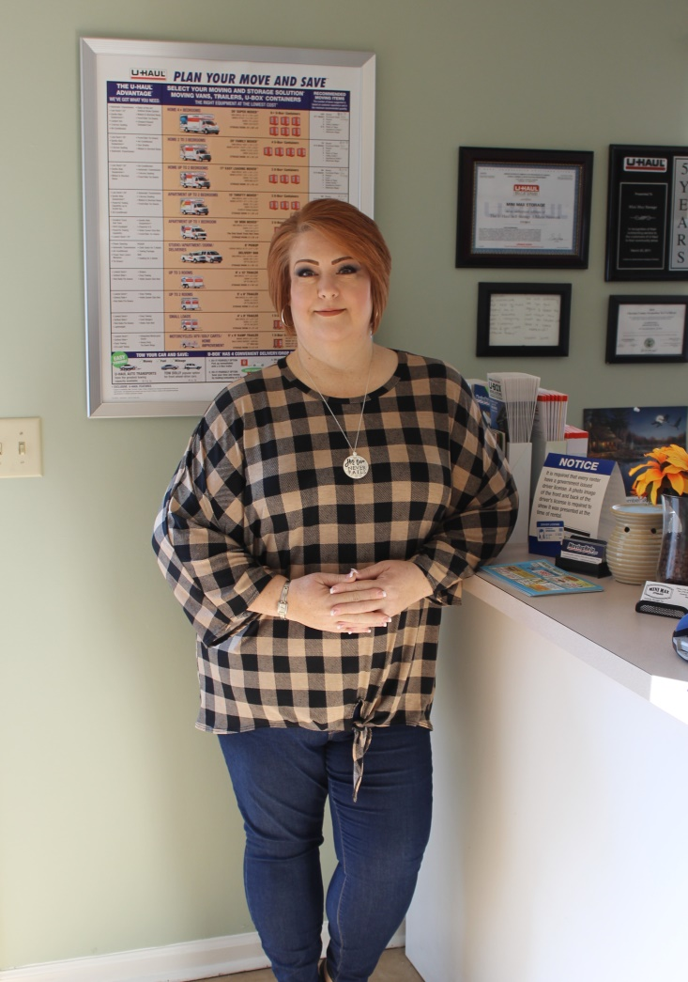
Property Manager: Amanda Shafer
Amanda is mostly known for:
She has been a Loyal, Hardworking, Committed, Honest and Resourceful Manager for the past 11 years.
She has raised two children 18/20 as well as a wife.
She has always been a great ambassador to our many customers and has worked to maintain great working relationships with many tenants.
She has always exceled in ancillary sales as well as truck rentals and insurance sales.
She has worked as a trainer for other Property Managers in our company and continues to work with other managers for scheduling and policy maters.
She has maintained positive income growth through rate management and occupancy improvements over the past years even during the tough economy of 2008-2016. Continues to improve occupancy as competition increased by 75% in the past two years.
She recently completed, the complete remodel of the Managers Office including repainting the office, and painting the art work herself.
On occasion she has been known to, don-a-cape as a crime fighter.
Mini-Max Storage

